Slide 1
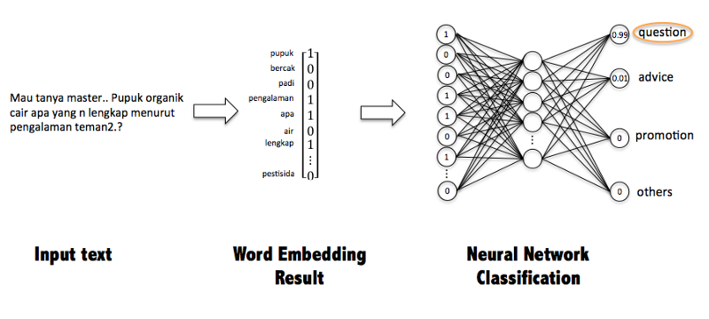
128*1 Matrix
128 layer
No of output tag layer
64 layer
Tag for [Start all exhibit one by one]
Demo
Science
[Name]
Give me a demo of the gallery?
Museums
Gallery
see
0
Exhibit
Demonstration
0
Visit

Slide 2
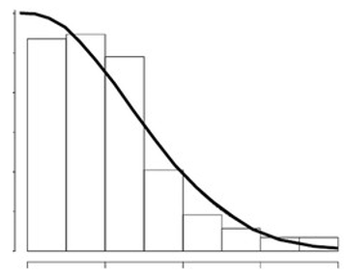
1
2
3
4
5
6
7
8

Slide 3
